Slide 1

MIE1624HF Group Project
Group 3
2020/12/01

Slide 2
Outline
Course curriculum design for MIE 1624: Intro to Data Science and Analytics
Data Science program curriculum design for a new technically- and business-oriented program: Master of Data Science and Artificial Intelligence
Data Science education EdTech effort: A diagnostic device for students to identify their skill gaps for their ideal career

Slide 3
Data used
Kaggle survey data (2019)
-> important skills current workers in the field use
Online course data from:
- Data Camp
- Coursera
-> important skills taught by online courses in the field of data science
Job posting data from:
- Indeed
- Monster
- LinkedIn
-> important skills for employment in field of data science
Notes:
Kaggle data should be thrown in here.

Slide 4
MIE 1624: Intro to Data Science and Analytics

Slide 5
MIE 1624: Intro to Data Science and Analytics
What are the important and common skills for students in data science and analytics?
Data driven approach to select skills to be taught in the course
Method:
(1) Look at the emphasized skills on online courses websites
(2) Look at the skills most commonly used by people working in the data science field from Kaggle survey (2019)

Slide 6
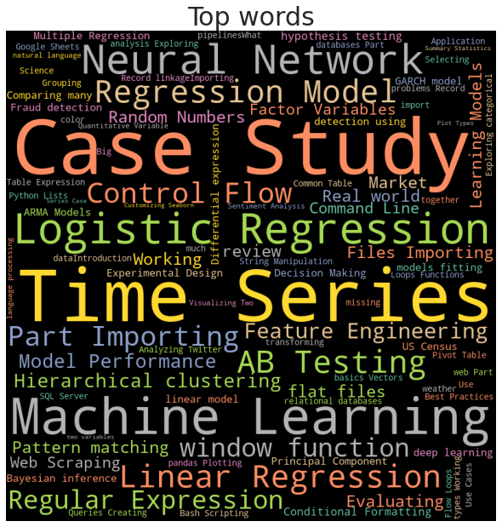
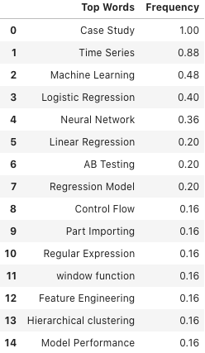
DataCamp top elements

Slide 7
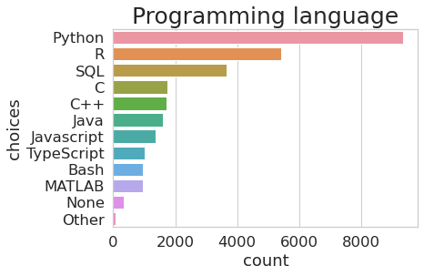
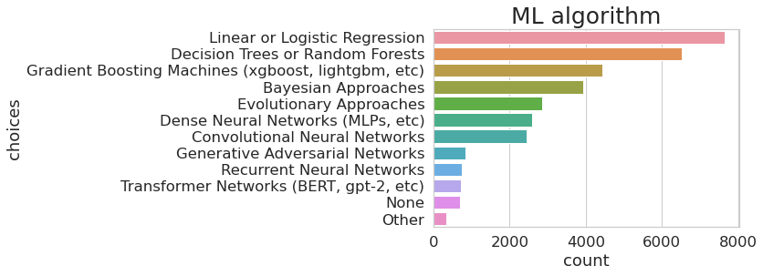
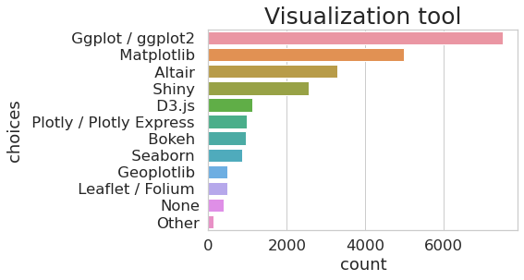
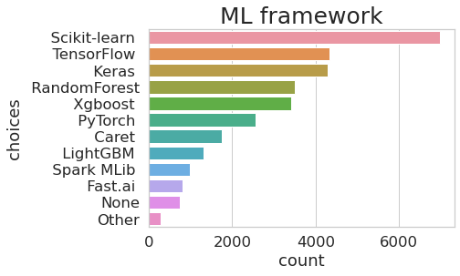
Kaggle survey (2019) non-students

Slide 8
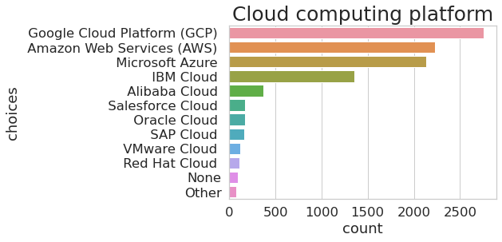
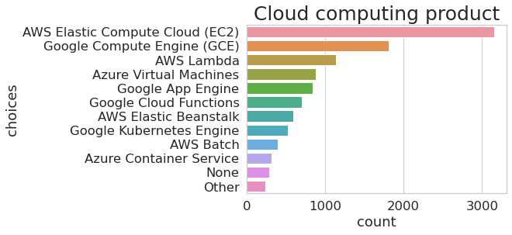
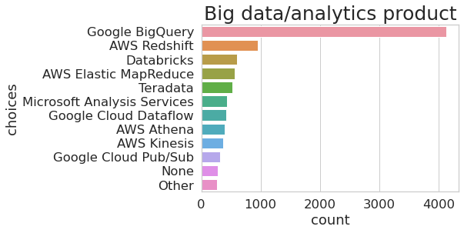
Kaggle survey (2019) non-students

Slide 9
MIE 1624 Course Curriculum
 | LECTURE TOPIC | DESCRIPTION | TAKE-HOME PRACTICE
WEEK 1 | Introduction to Python + integrated development environment (e.g., Jupyter, spyder) | Introduce Python language; Important basic libraries e.g., pandas, numpy, etc. + Jupyter notebook | Practice importing, manipulating excel/csv data with the basic python libraries.
WEEK 2 | SQL + data importing/cleaning | Data Structures and Database Management/SQL for data storage, retrieval and manipulation + web-scraping | Practice web-scraping + cleaning/wrangling of the scraped data with python.
WEEK 3 | Statistics with Python | Descriptive stats, statistical inference, hypothesis testing, bootstrapping, bayesian stats, AB-testing etc. + statsmodel in python | Practice exploring, describing, inferring data through bootstrapping and hypothesis testing in python.
WEEK 4 | Visualization with Python | Data visualization through libraries such as Matplotlib, plotly, and seaborn | Given different data types, with different number of groups, practice plotting appropriate graph types to visualize the data with python library.

Slide 10
WEEK 5 | Cloud computing platform/products | Introduction to useful cloud computing platforms (e.g., google cloud, amazon, IBM) and products + big data analytics products (e.g., Google BigQuery) | Practice using at least two cloud computing platforms and products to process/analyze data.
WEEK 6 | Supervised ML | linear/logistic regressions, Nearest neighbor, Naive Bayes, Decision Trees, SVM, ensemble models, etc + sklearn in python | Practice using at least 3 different types of supervised ML model on one dataset.
WEEK 7 | Unsupervised ML | All types of clustering (e.g, Hierarchical clustering, K-means clustering, K-NN, Principal Component Analysis, Singular Value Decomposition, Independent Component Analysis) | Practice using at least 3 different types of unsupervised ML model on one dataset.
WEEK 8 | Neural Network | Main types of neural networks and its applications. | Practice optimizing a neural network with backward propagation.
WEEK 9 | Deep learning | Deep learning with Keras | Use the Keras library to build deep learning models for both regression and classification.
WEEK 10 | Final project | Solve practical business problems combining data domain-specific knowledge with business analysis and communication skills

Slide 11
Master of Data Science and
Artificial Intelligence

Slide 12
Master of Data Science and Artificial Intelligence
Comprehensive preparation ranging from technical skills and topics to interpersonal managing/collaborative training
Method:
(1) Popular topics from DataCamp and Coursera
(2) Important programming skills required in job postings
(3) Hierarchical clustering of keywords in job posting data to validate
important topics

Slide 13
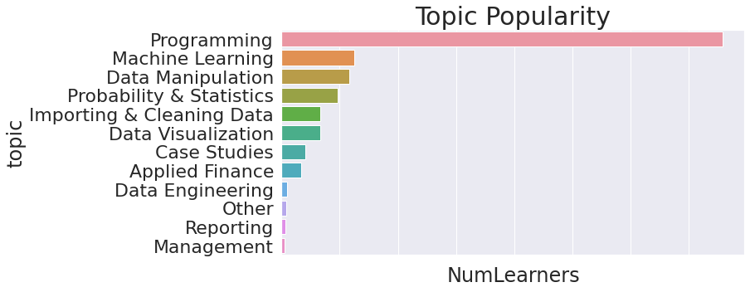
Online courses under each topic
Grouped Topics from DataCamp:
Data Engineering
Programming, importing & cleaning data
Data manipulation
Data visualization
Probability and stats
Machine learning (+ deep learning)
Applied finance and reporting

Slide 14
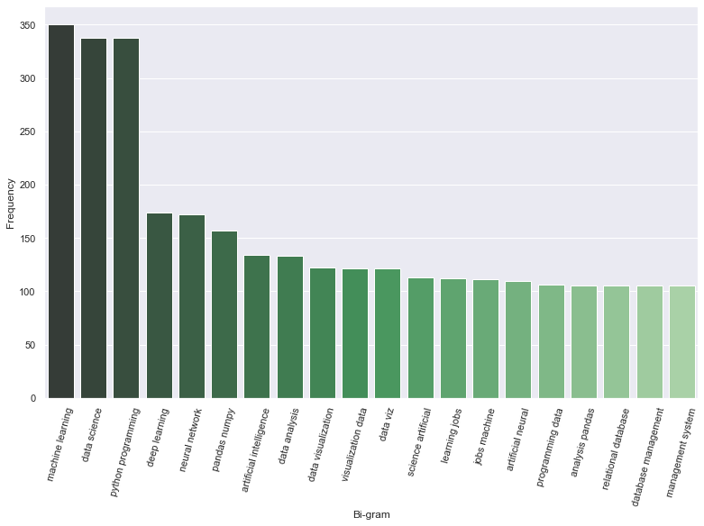
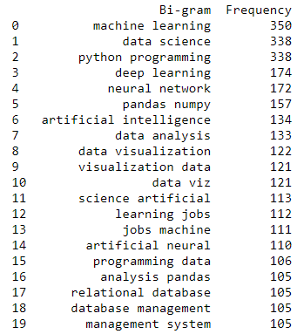
Coursera Skill-sets

Slide 15
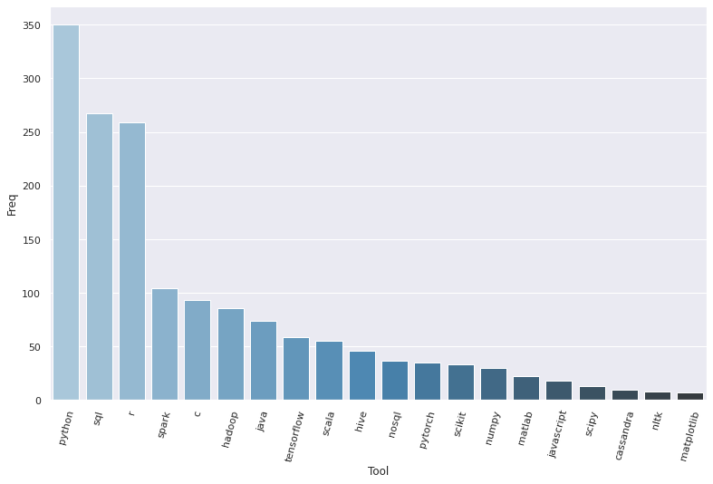
Top skills required in job postings
 | TOP 5 SKILLS
1 | Python
2 | SQL
3 | R
4 | Spark
5 | C

Slide 16
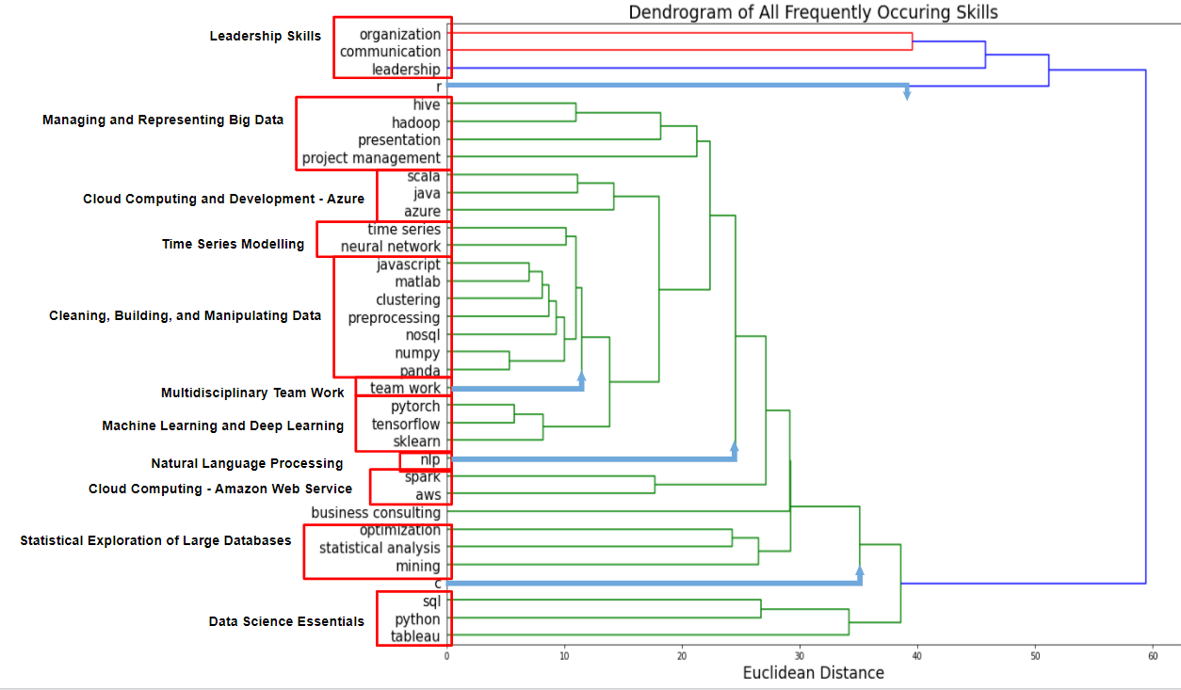
Hierarchical clustering of keywords in job postings
Notes:
We decided to use a dendrogram to provide some confluence to our previous analysis and validate some relationships.
The following dendrogram was created to to clusters skills based on inter-job description term frequencies or more concretely, which words or groups of words appear most frequently in each job description
The words we chose to analyze are
The top 10 most popular general skills found in job descriptions, And the most popular programming languages and software packages found
from from Josh’s analysis of popular coursera courses and job descriptions
Based on this, the clusters shown on the dendrogram were derived.
due to the large amount of terms analysed the dendrogram could be better interpreted by
Zeroing in on the most popular languages and software platforms,

Slide 17
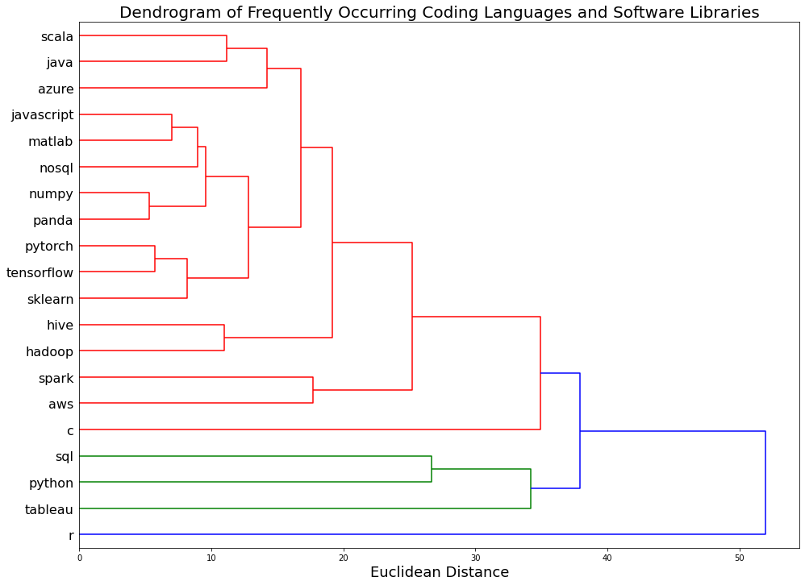
Hierarchical clustering of keywords in job postings
Cloud Computing - Microsoft Azure
Cleaning, Building, and Manipulating Data
Machine Learning and Deep Learning
Managing Big Data
Cloud Computing -
Amazon Web Service
Data Science Essentials
Python
Visualization
Databases
Notes:
doing so the following dendrogram was derived
Here we see 6 clear clusters and it is nice to see that the clusters make sense.
We also see languages like r and c tying into larger clusters that contain more specific skills. All in all this reduced dendrogram was very informative and will be used in designing a relevant curriculum for the masters program

Slide 18
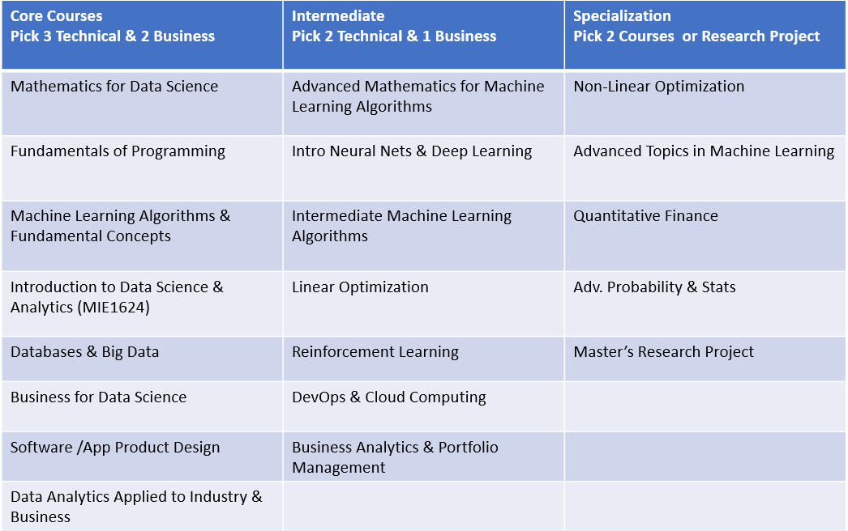
Master of Data Science & AI
Program Structure

Slide 19
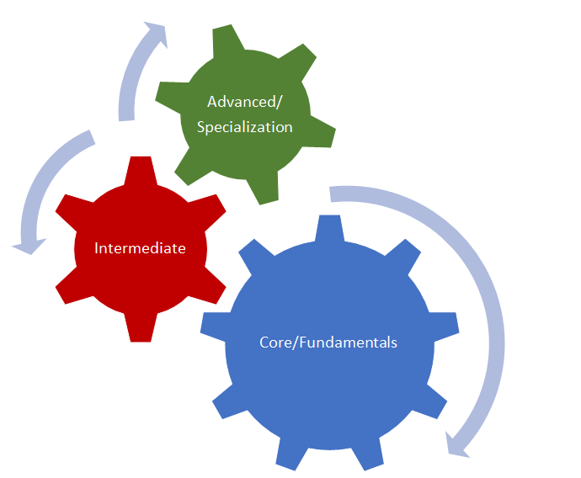
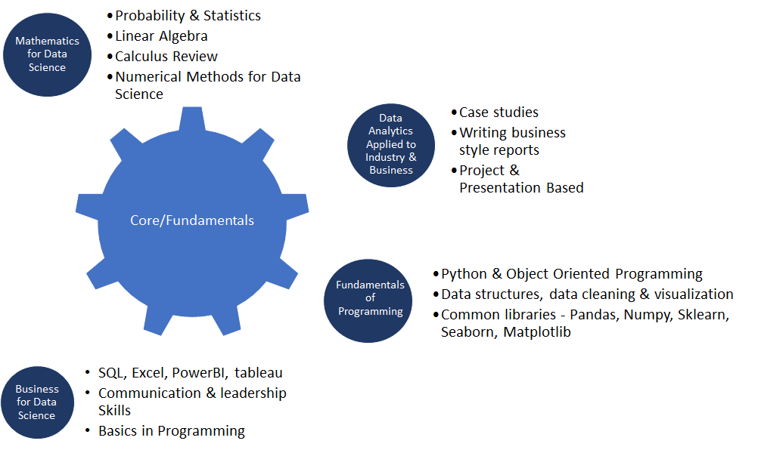
Master of Data Science & AI
Program Structure

Slide 20
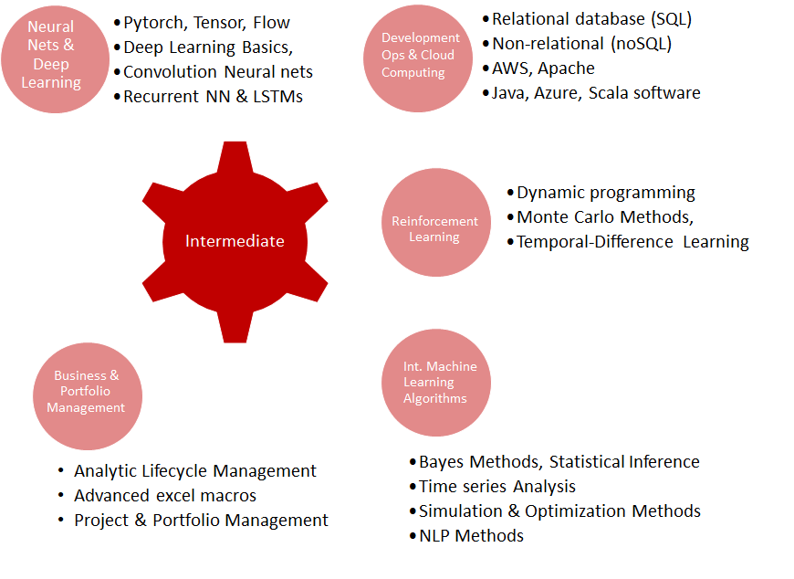
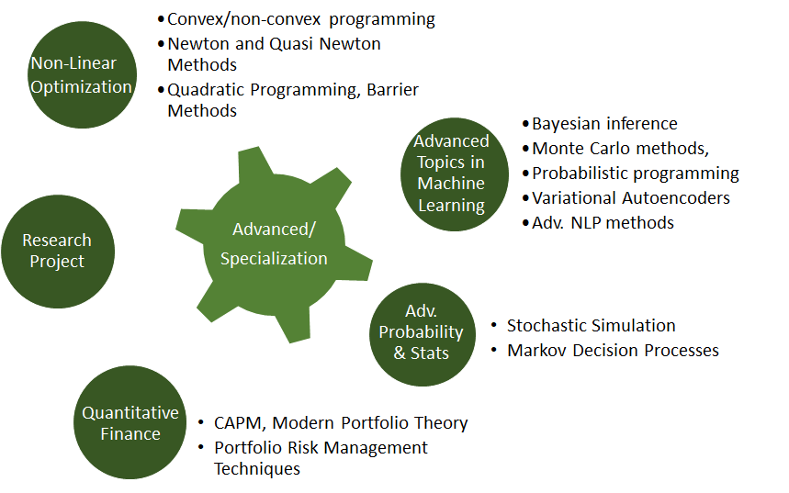
Master of Data Science & AI
Program Structure

Slide 21
Data Science education EdTech effort:
Diagnostic device spotting skill gaps

Slide 22
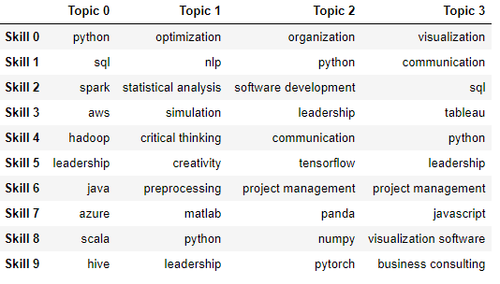
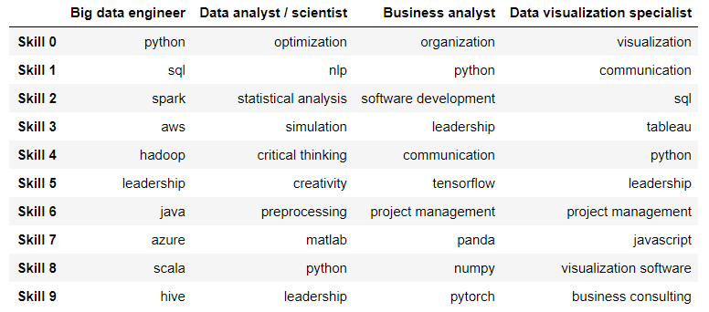
Diagnostic device spotting skill gaps
Research question: Based on a student’s existing skills and knowledge, what type of career in data science industry matches the most? and what are the gaps between existing skill set and the job required skills
Latent Dirichlet Allocation (LDA) for topic extraction
Obtain topics (area specialization) of jobs related to data science
Obtain weighed skills of each topic
Summarize each topic based on clustered skills
Notes:
Learned a lot of skills from school and want to find a job in data science?
Want to know how qualified you are and what are the skills you are lacking?
This is the device that you need!

Slide 23
Diagnostic device spotting skill gaps
Match input skills to area specialization and diagnose missing skills
Demo: https://skillanalysis.herokuapp.com/

Slide 24
Thank you for your attention

